Slide 1
Thermodynamics
Chapter-04

Slide 2
Definition of thermodynamic
Thermodynamic is the branch of physics that deals with the concepts of heat and temperature and the inter-conversion of heat and other forms of energy.

Slide 3
Thermal Equilibrium
Heat: heat is something that is transferred from a substance at a higher temperature to that at a lower temperature.
This transfer continues till the level of heat content in both the substances is the same.
Then we say that a thermal equilibrium is reached between the two substances
Hence, when two objects are at the same temperature, they are in thermal equilibrium.
This concept of thermal equilibrium is used in the Zeroth Law of thermodynamics.

Slide 4
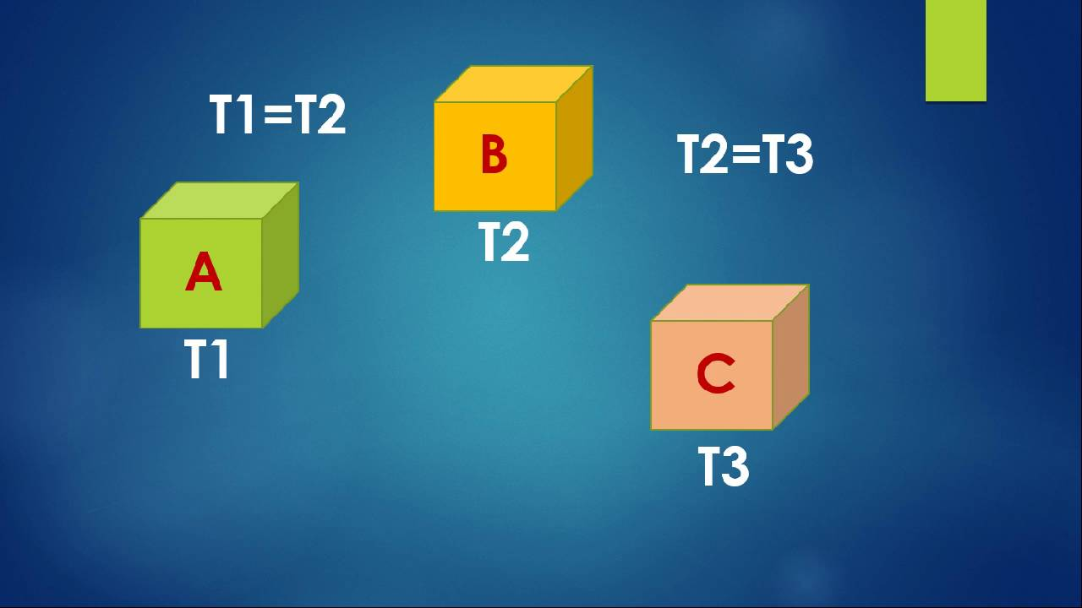
Zeroth Law of Thermodynamics
If two systems are each in thermal equilibrium with a third system, they are also in thermal equilibrium with each other.
Consider 3 system A, B, and C
If system A and C are in thermal equilibrium, and systems A and B are in thermal equilibrium, then systems B and C must be in thermal equilibrium.
For example, when we use a thermometer to measure temperature of an object, we use the same principle
When the thermometer and the object are in thermal equilibrium, the thermometer indicates the temperature of the object
The zeroth law, therefore, enables us to use a thermometer to compare the temperatures of different objects

Slide 5
Heat, Internal Energy and Work
when two substances, initially at different temperatures, are brought in contact with each other, the substance at higher temperature loses its heat and the substance at lower temperature gains it.
Internal Energy: Internal energy is defined as the energy associated with the random, disordered motion of the molecules of a system.
It is different than the macroscopic ordered energy of a moving object.
The internal energy of a substance is the total energy of all its atoms/molecules.
For an ideal monatomic gas such as argon, the internal energy is just the translational kinetic energy of the atoms having a linear motion.
For a polyatomic gas such as carbon di-oxide, we consider the rotational and vibrational kinetic energy of the molecules in addition to their translational kinetic energy.
In case of liquids and solids, we need to consider the potential energy of the molecules due to the intermolecular attractive forces amongst them
This internal energy of a system is denoted by U .

Slide 6
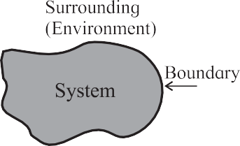
Thermodynamic system and Thermodynamic Process
A thermodynamic system is a collection or a group of objects that can form a unit which may have ability to exchange energy with its surroundings.
Anything that is not a part of the system is its surrounding or its environment.
For example, water kept in a vessel is a system, the vessel is its boundary and the atmosphere around it is its surrounding.
A thermodynamic process is a process in which the thermodynamic state of a system is changed.
When water boil in vessel, the pressure, volume and temperature charges, thus boiling process is thermodynamic process

Slide 7
Types of thermodynamic system
Thermodynamic systems can be classified on the basis of the possible transfer of heat and matter to environment.
Based on this, they are classified as open, closed or isolated systems.
open system: An open system is a system that freely allows exchange of energy and matter with its environment.
For example, water boiling in a kettle is an open system.
Close system: A closed system, on the other hand, does not allow the exchange of matter but allows energy to be transferred.
For example, water boiling in a boiler is a closed system.
Isolated system: An isolated system is completely sealed (isolated from its environment). Matter as well as heat cannot be exchanged with its environment.
A thermos flask is a very familiar example of an isolated system

Slide 8
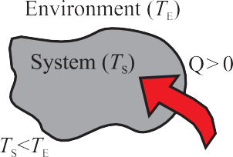
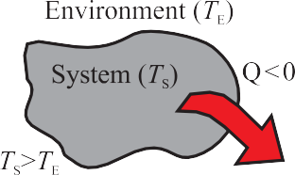
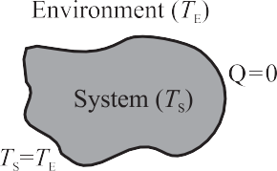
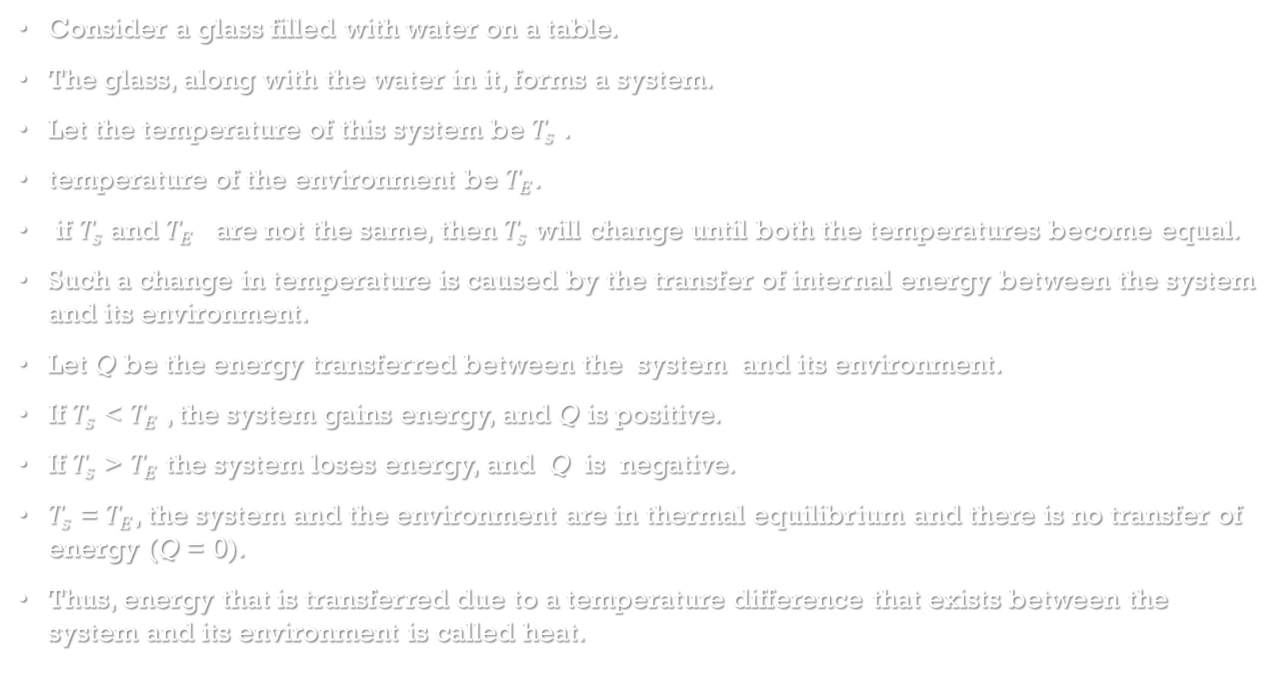
Heat
Consider a glass filled with water on a table.
The glass, along with the water in it, forms a system.
Let the temperature of this system be $T_{s}$ .
temperature of the environment be $T_{E}$.
if $T_{s}$ and $T_{E}$ are not the same, then $T_{s}$ will change until both the temperatures become equal.
Such a change in temperature is caused by the transfer of internal energy between the system and its environment.
Let Q be the energy transferred between the system and its environment.
If $T_{s}$ < $T_{E}$ , the system gains energy, and Q is positive.
If $T_{s}$ > $T_{E}$ the system loses energy, and Q is negative.
$T_{s}$ = $T_{E}$, the system and the environment are in thermal equilibrium and there is no transfer of energy (Q = 0).
Thus, energy that is transferred due to a temperature difference that exists between the system and its environment is called heat.

Slide 9
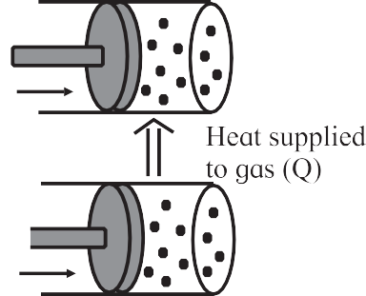

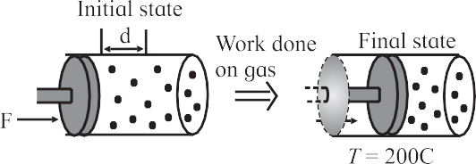
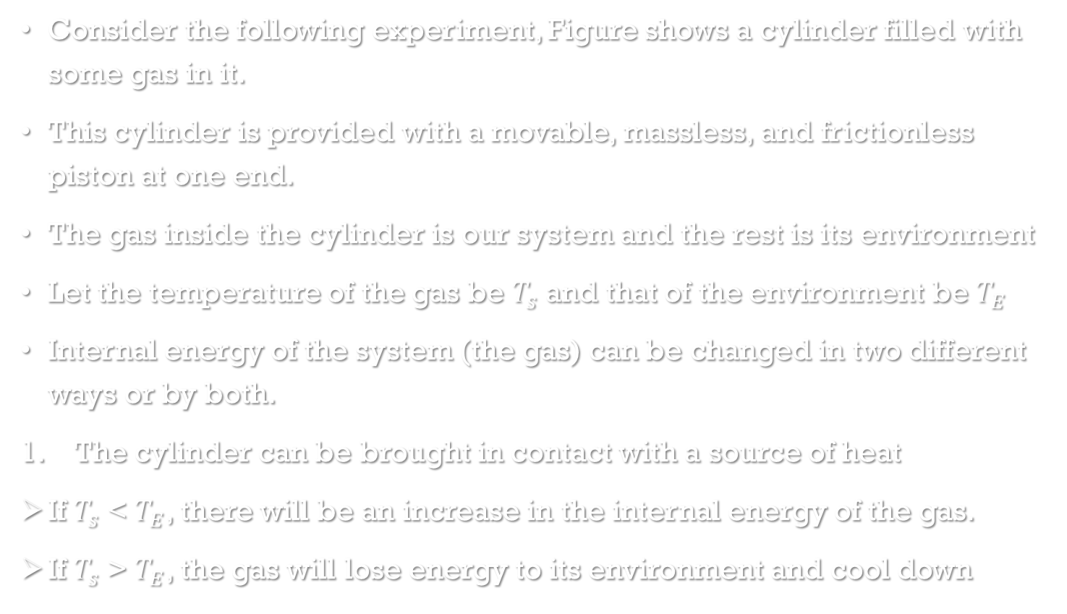
Change in Internal Energy of a System
Final state
Consider the following experiment, Figure shows a cylinder filled with some gas in it.
This cylinder is provided with a movable, massless, and frictionless piston at one end.
The gas inside the cylinder is our system and the rest is its environment
Let the temperature of the gas be $T_{s}$ and that of the environment be $T_{E}$
Internal energy of the system (the gas) can be changed in two different ways or by both.
The cylinder can be brought in contact with a source of heat
If $T_{s}$ < $T_{E}$, there will be an increase in the internal energy of the gas.
If $T_{s}$ > $T_{E}$, the gas will lose energy to its environment and cool down
Change in internal energy by heating
Change in internal energy by doing work

Slide 10
The other way to increase the internal energy of the gas is to quickly push the piston inside the cylinder, so that the gas is compressed
In this case, we know that the piston does some work on the gas in moving it through some distance.
The gas gains energy and its temperature is increased
if the gas pushes the piston out, so that the gas is expanded, some work is done by the gas
It loses some of its energy and the gas cools down.
Thus, we see that the internal energy of a system can be changed in two different ways, 1) by heating it or 2) by doing work on it.
Conclusion of this experiment leads us to a very important principle of thermodynamics.
Change in internal energy by doing work

Slide 11
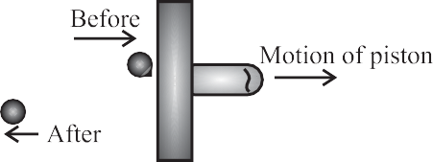
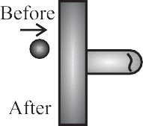
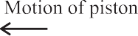
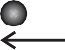
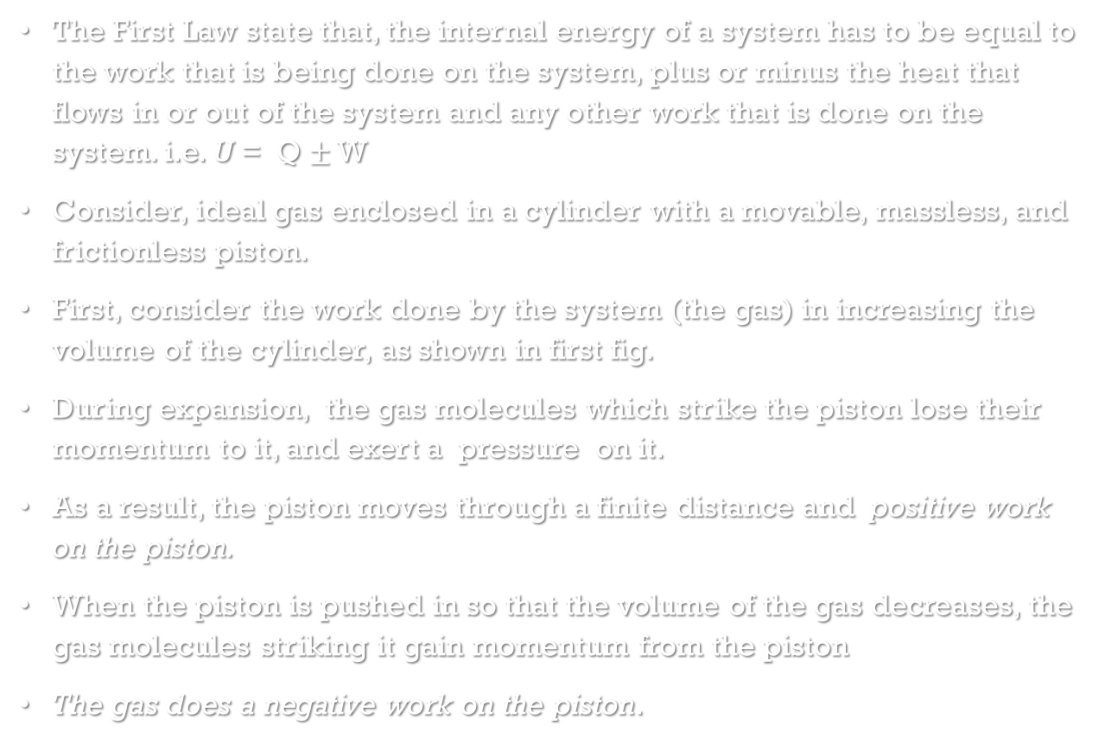
First Law of Thermodynamics
The First Law state that, the internal energy of a system has to be equal to the work that is being done on the system, plus or minus the heat that flows in or out of the system and any other work that is done on the system. i.e. U = Q $±$ W
Consider, ideal gas enclosed in a cylinder with a movable, massless, and frictionless piston.
First, consider the work done by the system (the gas) in increasing the volume of the cylinder, as shown in first fig.
During expansion, the gas molecules which strike the piston lose their momentum to it, and exert a pressure on it.
As a result, the piston moves through a finite distance and positive work on the piston.
When the piston is pushed in so that the volume of the gas decreases, the gas molecules striking it gain momentum from the piston
The gas does a negative work on the piston.

Slide 12
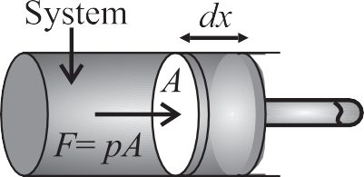
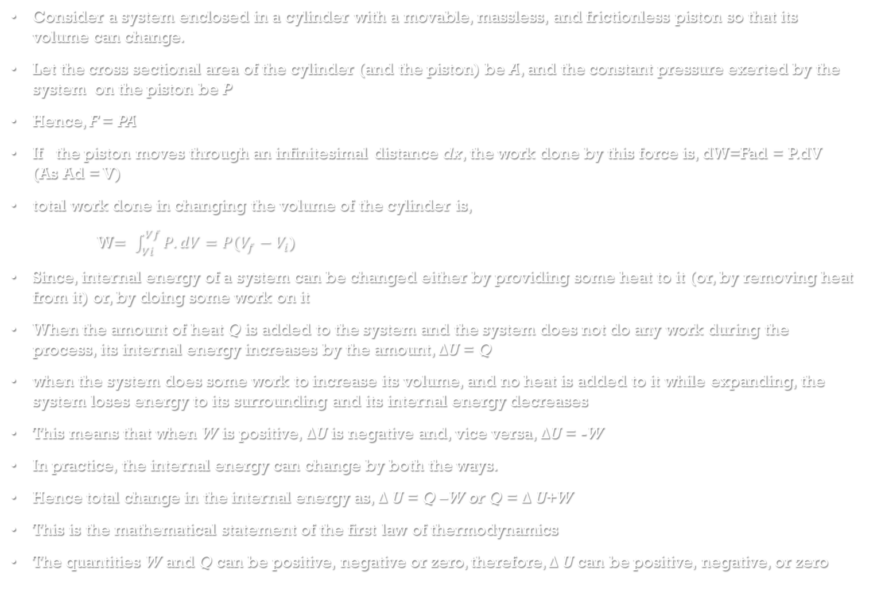
Consider a system enclosed in a cylinder with a movable, massless, and frictionless piston so that its volume can change.
Let the cross sectional area of the cylinder (and the piston) be A, and the constant pressure exerted by the system on the piston be P
Hence, F = PA
If the piston moves through an infinitesimal distance dx, the work done by this force is, dW=Fad = P.dV (As Ad = V)
total work done in changing the volume of the cylinder is,
W$= \int_{Vi}^{Vf}{P.dV}=P(V_{f}−V_{i}$)
Since, internal energy of a system can be changed either by providing some heat to it (or, by removing heat from it) or, by doing some work on it
When the amount of heat Q is added to the system and the system does not do any work during the process, its internal energy increases by the amount, $∆$U = Q
when the system does some work to increase its volume, and no heat is added to it while expanding, the system loses energy to its surrounding and its internal energy decreases
This means that when W is positive, $∆$U is negative and, vice versa, $∆$U = -W
In practice, the internal energy can change by both the ways.
Hence total change in the internal energy as, $∆$U = Q –W or Q = $∆$U+W
This is the mathematical statement of the first law of thermodynamics
The quantities W and Q can be positive, negative or zero, therefore, $∆$U can be positive, negative, or zero

Slide 13
Property of a system or a system variable
It is any measurable or observable characteristic or property of a system when the system remains in equilibrium.
We use the term variable to describe characteristic of a system
For example, pressure, volume, temperature, density and mass of a system are some of the variables that are used to describe a system

Slide 14

Intensive and Extensive variables
Intensive variables do not depend on the size of the system
Ex. Consider a system in equilibrium and divided into two equal compartments, each with half the original volume. We notice that the pressure p, the temperature T, and the density $ρ$ are the same in both compartments. These are intensive variables.
Extensive variables depend on the size of the system.
Ex. The total mass M, and the internal energy U of the system are equally divided in the two compartments and are extensive variables of the system.

Slide 15
Thermodynamic equilibrium
A system is in thermodynamic equilibrium if the following three conditions of equilibrium are satisfied simultaneously. These are,
1) Mechanical equilibrium, 2) Chemical equilibrium, and 3) Thermal equilibrium.
Mechanical equilibrium: When there are no unbalanced forces within the system and between the system and its surrounding, the system is said to be in mechanical equilibrium.
The system is also said to be in mechanical equilibrium when the pressure throughout the system and between the system and its surrounding is the same and does not change with time.
Chemical equilibrium: A system is said to be in chemical equilibrium when its chemical composition is the same throughout and does not change with time.
Thermal equilibrium: When the temperature of a system is uniform throughout and does not change with time, the system is said to be in thermal equilibrium

Slide 16
Thermodynamic State Variables and Equation of State
Every equilibrium state of a thermodynamic system is completely described by specific values of some macroscopic variables, also called thermodynamic state variables
In simple words, thermodynamic state variables describe the equilibrium states of a system
The mathematical relation between the state variables is called the equation of state
Ex. Ideal gas equation, PV=nRT

Slide 17
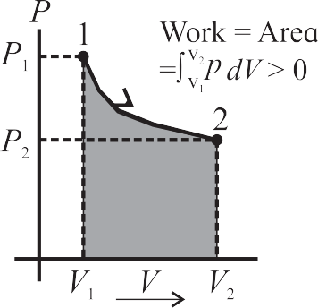
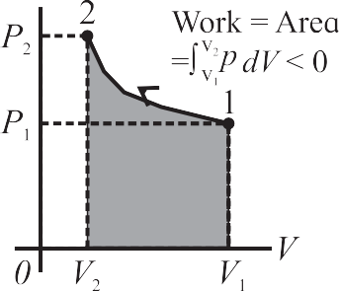
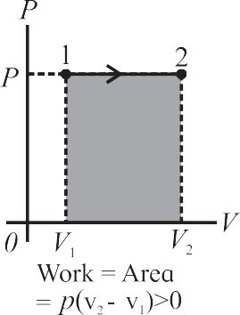

The P - V diagram
Since W$= \int_{Vi}^{Vf}{P.dV}$
The integral in this equation can be evaluated if we know the relation between the pressure p and the volume V, or the path between the limits of integration
Since this integral represents the work done in changing the volume of the gas, the area under the p-V curve also represents the work done in this process
Figure 1 shows expansion of the gas and the pressure of the gas decreases.
The work done by the gas in this case is positive because the volume of the gas has increased.
Similarly, Fig 2 shows compression and the pressure of the gas is increased and the work done by the gas is now negative
Figure 3 shows the p-V diagram when the volume of the gas changes from $V_{i}$ to $V_{f}$ at a constant pressure.
The work done during volume change at constant pressure is W = $P(V_{f}−V_{i}$) =0
When the volume is constant in any thermodynamic process, the work done is zero

Slide 18
Thermodynamic Process
Thermodynamic Process: A thermodynamic process is a procedure by which the initial state of a system changes to its final state.
Quasi static process: processes in which changes in the state variables of a system occur infinitesimally slowly are called quasi static Process.
Path: When a thermodynamic system changes from its initial state to its final state, it passes through a series of intermediate states. This series of intermediate states when plotted on a P - V diagram is called a path.

Slide 19
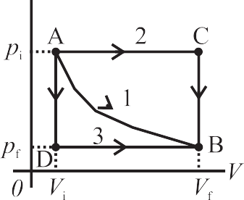
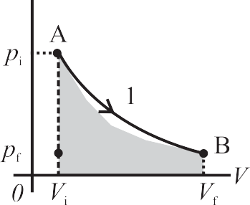
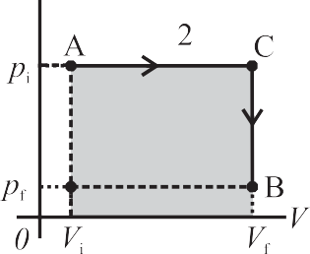

Work Done During a Thermodynamic Process
As shown in fig 1, which describes different ways in which we can change the state of a system.
The system is initially at state A ($P_{i}$, $V_{i}$)on the p-V diagram with pressure is $P_{i}$and volume is $V_{i}$.
The final state of the system is shown by the point B ($P_{f}$, $V_{f}$).
When the system changes itself from A to B along the path 1, both its pressure and volume change
The pressure decreases while the volume increases, The work done by the system is positive.
The work done is given by the area under the curve 1
Second way to change the state from A to state B is path 2 as shown in .
In this case, the volume increases to $V_{f}$ from the point A up to the point C at the constant pressure P.
The pressure then decrease to $P_{f}$ as shown. The volume remains constant during this change.
The system is now in the state B with its coordinates given by ($P_{f}$, $V_{f}$)
The work done in this process is represented by the shaded area under the curve 2 as in Fig3

Slide 20
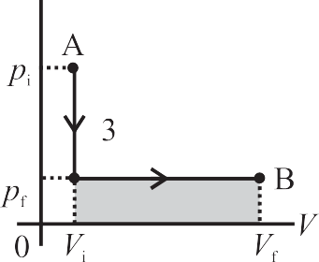

Third way to change the state from A to state B is path 3 as shown in Fig.
In this case, the pressure decreases from $P_{i}$ to $P_{f}$ but the volume remains the same.
Next, the volume changes to $V_{f}$ at constant pressure P.
The work done in this process is represented by the shaded area under the curve 3 as in fig.
It is easily noticed that in the three cases we discussed, the amount of work done is not the same
It is concluded that the work done by a system depends not only on the initial and the final states, but also on the intermediate states, i.e.,on the paths along which the change takes place

Slide 21
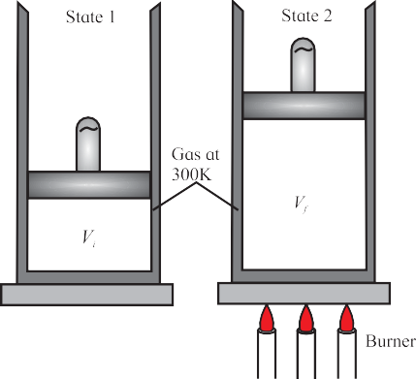

Heat Added During a Thermodynamic Process
Thermodynamic state of a system can also be changed by adding heat.
Thermodynamic system consisting of an ideal gas confined to a cylinder with a movable, frictionless, and massless piston.
To change the initial volume $V_{i}$ of the gas to the final volume $V_{f}$ at a constant temperature.
There are two different ways in which this change in volume can be made
Fig. 1, shows the first method In this case, the gas is heated slowly, in a controlled manner so that it expands at a constant temperature.
It reaches the final volume $V_{f}$ isothermally.
The system absorbs a finite amount of heat during this process.

Slide 22

In the second case, fig. shows gas cylinder is now surrounded by an insulating material and it is divided into two compartments by a thin, breakable partition.
The compartment X has a volume $V_{i}$ and the compartment Y has a volume $V_{i}′$so that V=$V_{i}$+ $V_{i}′$ .
The compartment X of the cylinder is filled with the same amount of gas at the same temperature as that in the first case.
The compartment Y is empty, it contains no gas particles or any other form of matter.
The partition is now suddenly broken. This causes a sudden, uncontrolled expansion of the volume of the gas
There is no exchange of heat between the gas and its environment because the cylinder is now surrounded by an insulating material.
The final volume of the system after the partition is broken is V
In this case, the gas has not done any work during its expansion because it has not pushed any piston or any other surface for its expansion
Such expansion is called free expansion.
In case of the method 1, there is an exchange of heat and In case of the method 2, there is no exchange of heat and also, the system does not do any work at all because there is no displacement of any piston or any other surface.
To conclude, heat transferred to a system also depends on the path

Slide 23
Classification of Thermodynamic Processes
For the sake of measurement, any one of the state variables is held constant and other two are varied.
This leads us to a very useful way of classifying thermodynamic processes.
Reversible and Irreversible Processes
Isothermal process
Isobaric process
Isochoric process
Adiabatic process
Cyclic Process
Free Expansion

Slide 24
Reversible and Irreversible Processes
Irreversible Processes: The process do not restore the initial state of the system is called irreversible process.
Eg. Puncturing an inflated balloon or a tire, rubbing our palms together, burning a candle.
Reversible Process: The process in which initial sates of the system can be restored is called Reversible process.
Ex. Melting of ice, freezing of water, boiling of water, condensation of steam
A real thermodynamic process will always encounter some loss due to friction or some other dissipative forces

Slide 25
Cause of Irreversibility
There are two main reasons of the irreversibility of a thermodynamic process
Many processes such as a free expansion or an explosive chemical reaction take the system to non-equilibrium states
Most processes involve friction, viscosity or some other dissipative forces, which can be minimized at best, but cannot be fully eliminated

Slide 26
Assumptions for discussion of thermodynamic processes
Majority of the thermodynamic processes we will be discussing in the following sections are reversible. That is, they are quasistatic in nature. They are extremely slow and the system undergoes infinitesimal change at every stage except the adiabatic processes. The system is, therefore, in thermodynamic equilibrium during all the change
The ‘system’ involved in all the processes is an ideal gas enclosed in a cylinder having a movable, frictionless, and massless piston. Depending on the requirements of the process, the walls of the cylinder can be good thermal conductors (for an isothermal process) or can be thermally insulating (for an adiabatic process).
The ideal gas equation is applicable to the system.

Slide 27

Isothermal process
A process in which change in pressure and volume takes place at a constant temperature is called an isothermal process or isothermal change.
For such a system $∆$T = 0. Isothermal process is a constant temperature process
This is possible when a system is in good thermal contact with its environment, and the transfer of heat from, or to the system, is extremely slow so that thermal equilibrium is maintained throughout the change

Slide 28
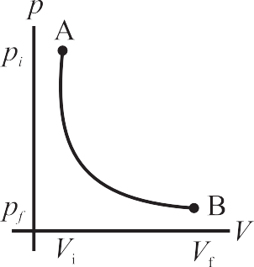

Thermodynamics of Isothermal Process
The equation of state for an isothermal change is given by PV= constant
If $P_{i}$ , $V_{i}$ and $P_{f}$, $V_{f}$ are the variables of a system in its initial and the final states respectively then, $P_{i}$ $V_{i}=P_{f} V_{f}=constant$
The work done in an infinitesimally small isothermal expansion is given by dW = P.dV
Hence total work done W=$\int_{V_{i}}^{V_{f}}{\text{P}\text{.}\text{dV}}$
But PV = nRT, hence W=nRT$\int_{V_{i}}^{V_{f}}{\frac{dV}{V}}=nRT(ln$ $V_{i}−ln V_{f}$)= nRT $\ln{\frac{V_{f}}{V_{i}}}$
For an ideal gas, its internal energy depends on its temperature.
Therefore, during an isothermal process, the internal energy of an ideal gas remains constant ($∆$U = 0) because its temperature is constant ($∆$T = 0).
Using first law of thermodynamic Q= W $∴$ Q=W=nRT $\ln{\frac{V_{f}}{V_{i}}}$
Thus, the heat transferred to the gas is completely converted into the work done
Figure shows the P - V diagram of an isothermal process

Slide 29
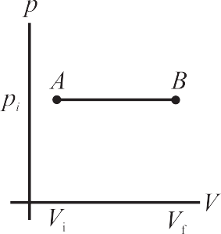
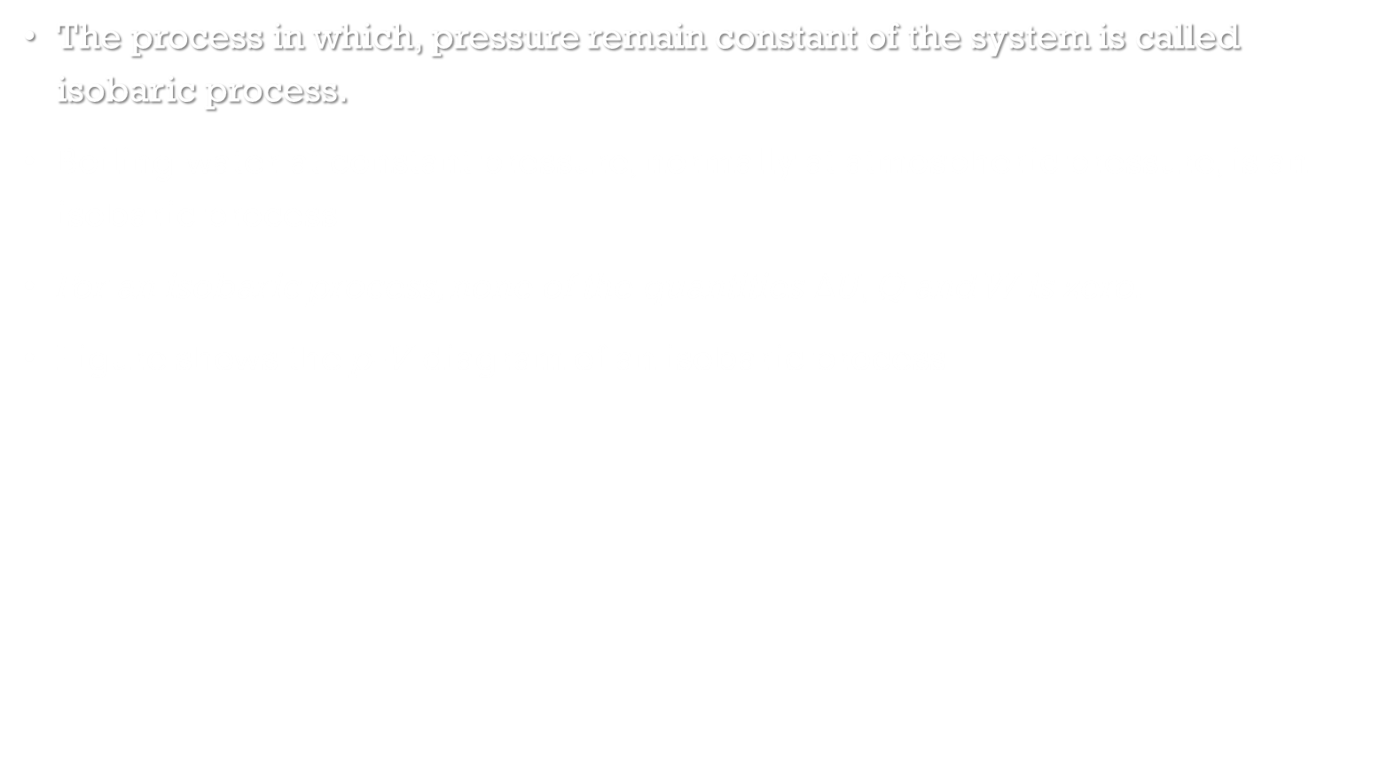
Isobaric process
The process in which, pressure remain constant of the system is called isobaric process.
Boiling water at constant pressure, normally at atmospheric pressure, is an isobaric process
For an isobaric process, none of the quantities $∆$U, Q and W is zero.
Figure shows the p-V diagram of an isobaric process

Slide 30

Thermodynamics of Isobaric process
Consider an ideal gas undergoing volume expansion at constant pressure.
If $V_{i}$ and $T_{i}$ are its volume and temperature in the initial state of a system and $V_{f}$ and $T_{f}$are its final volume and temperature respectively, the work done in the expansion is given by, W= PdV = P ($V_{f}$-$V_{i}$) = nR ($T_{f}$ - $T_{i}$ )
The change in the internal energy of a system is given by, $∆U=nC_{V} ∆$T= $nC_{V}\text{(}T_{f} \text{− }T_{i} \text{)}$. Where, $C_{V}$ is the specific heat at constant volume.
According to the first law of thermodynamics, the heat exchanged is given by, Q = $∆$U + W
$∴Q=$ $nC_{V}\text{(}T_{f} \text{− }T_{i} \text{)}$+ nR ($T_{f}$ - $T_{i}$ )
= n($C_{V}$+R) ($T_{f}$ - $T_{i}$ )
but $C_{V}$+R= $C_{P}$
$∴Q=$ n$C_{P}$ ($T_{f}$ - $T_{i}$ )
Equation tells that the temperature of a system changes in an isobaric process therefore, its internal energy also changes.
The heat exchanged is partly used for increasing the temperature and partly to do some work

Slide 31
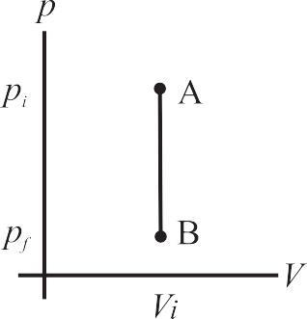

Isochoric process
The process in which, Volume remain constant of the system is called isobaric process
A system does no work on its environment during an isochoric change
Fig. shows P-V diagram of an isochoric process.
For an isochoric process, $∆$V =0, and we have, from the first law of thermodynamics, $∆$U = Q.
Heating a gas in a constant volume container or diffusion of a gas in a closed chamber are some examples of isochoric process.

Slide 32

Thermodynamics of Isochoric process
The first law of thermodynamics for isochoric process is Q = $∆$U
The change in internal energy is given by $∆$U= $nC_{V} ∆$T
The work done is given by, W = P. $∆$V = 0 (because $∆$V = 0).
$∴$ Q= $∆$U= $nC_{V} ∆$T

Slide 33
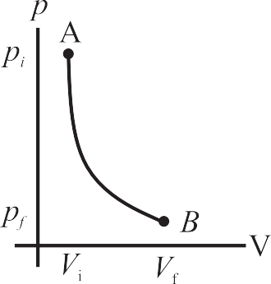

Adiabatic process
It is a process during which there is no transfer of heat from or to the system
Figure shows the P-V diagram of an adiabatic process
For an adiabatic change, Q = 0
Heat transfer to or from the system is prevented by either perfectly insulating the system from its environment, or by carrying out the change rapidly so that there is no time for any exchange of heat
For an adiabatic change, $∆$U = - W
When a system expands adiabatically, W is positive (work is done by the system) and $∆$U is negative, the internal energy of the system decreases
When a system is compressed adiabatically, W is negative (work is done on the system), and $∆$U is positive.

Slide 34

Thermodynamics of Adiabatic process
For an adiabatic process we have, P$V^{γ}=$ constant
Where $γ$=$\frac{C_{p}}{C_{V}}$
An adiabatic system can not exchange heat.
Therefore, when a system undergoes an adiabatic change, its temperature and internal energy both change, $∴∆\text{U}\text{=} nC_{V} ∆\text{T}$
W$= \int_{Vi}^{Vf}{P.dV}$
but for an adiabatic process, P.$V^{γ}$=C
W= C $\int_{Vi}^{Vf}{\frac{1}{V^{γ}}dV}$= C ${\left[\frac{V^{−γ+1}}{1−γ}\right]}_{Vi}^{Vf}$= C$\left[\frac{{V_{f}}^{−γ+1}−{V_{i}}^{−γ+1}}{1−γ}\right]$ = $\frac{C}{1−γ}$ $\left[\frac{1}{{V_{f}}^{γ−1}}−\frac{1}{{V_{i}}^{γ−1}}\right]$
Since process is adiabatic, hence $P_{i}V_{i}^{γ}=P_{f}V_{f}^{γ}$
$∴$ W=$\frac{1}{1−γ}$ $\left[\frac{P_{f} V_{f}^{γ}}{{V_{f}}^{γ−1}}−\frac{P_{i}V_{i}^{γ}}{{V_{i}}^{γ−1}}\right]$ = $\frac{1}{1−γ}$ $\left[P_{f}V_{f}−P_{i}V_{i}\right]$ = $\frac{nR(T_{i}−T_{f})}{1−γ}$
Equation implies that when the gas expands, W > 0, and $T_{i}$ > $T_{f}$.
This mean that the gas will cool down
if the gas is compressed W < 0, and $T_{i}$< $T_{f}$
This means that the gas will warm up

Slide 35
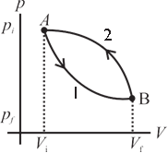

Cyclic Process
A thermodynamic process that returns a system to its initial state is a cyclic process
In this process, the initial and the final state is the same
Figure shows the P-V diagram of a cyclic process
For a cyclic process, the total change in the internal energy of a system is zero. ($∆$U = 0)
According to the first law of thermodynamics, we have, for a cyclic process, Q=W.

Slide 36

Free Expansion
These expansions are adiabatic expansions and there is no exchange of heat between a system and its environment
Also, there is no work done on the system or by the system.
Q = W = 0, and according to the first law of thermodynamics, $∆$U = 0
Free expansion is different than other thermodynamic processes we have discussed so far because it is an uncontrolled change
It is an instantaneous change and the system is not in thermodynamic equilibrium.
A free expansion cannot be plotted on a p-V diagram
Only its initial and the final state can be plotted

Slide 37
Heat Engines
Heat engines are devices that transform heat partly into work or mechanical energy
Heat engines work by using cyclic processes and involve thermodynamic changes.
Automobile engines are familiar examples of heat engines
A heat engine receives heat from a source called reservoir and converts some of it into work
Remember that all the heat absorbed is not converted into work by a heat engine. Some heat is lost in the form of exhaust.

Slide 38

heat engine elements
A working substance: It can be an ideal gas for an ideal heat engine
For a practical heat engine, the working substance can be a mixture of fuel vapour and air in a gasoline (petrol) or diesel engine, or steam in a steam engine.
It is the working substance that absorbs heat and does work
Hot and cold reservoir: The working substance interacts with the reservoirs.
The hot reservoir is the source of heat.
It is at a relatively high temperature and is capable of providing large amount of heat at constant higher temperature, $T_{H}$.
The cold reservoir absorbs large amount of heat from the working substance at constant lower temperature, TC.
It is also called as the sink.
Cylinder: Generally, the working substance is enclosed in a cylinder with a moving, frictionless, and massless piston.
The working substance does some work by displacing the piston in the cylinder
This displacement is transferred to the environment using some arrangement such as a crank shaft which transfers mechanical energy to the wheels of a vehicle

Slide 39
Heat engines types and steps of working
Types: Heat engines are of two basic types
External combustion engine: In an external combustion engine, the working substance is heated externally as in case of a steam engine.
Internal combustion engine: In case of the internal combustion engine, the working substance is heated internally similar to an automobile engine using gasoline or diesel.
Steps of working: Any heat engine works in following three basic steps
The working substance absorbs heat from a hot reservoir at higher temperature.
Part of the heat absorbed by the working substance is converted into work.
The remaining heat is transferred to a cold reservoir at lower temperature

Slide 40
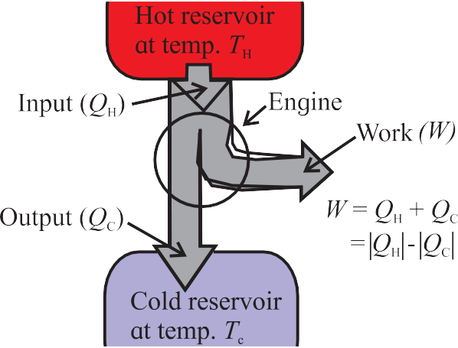
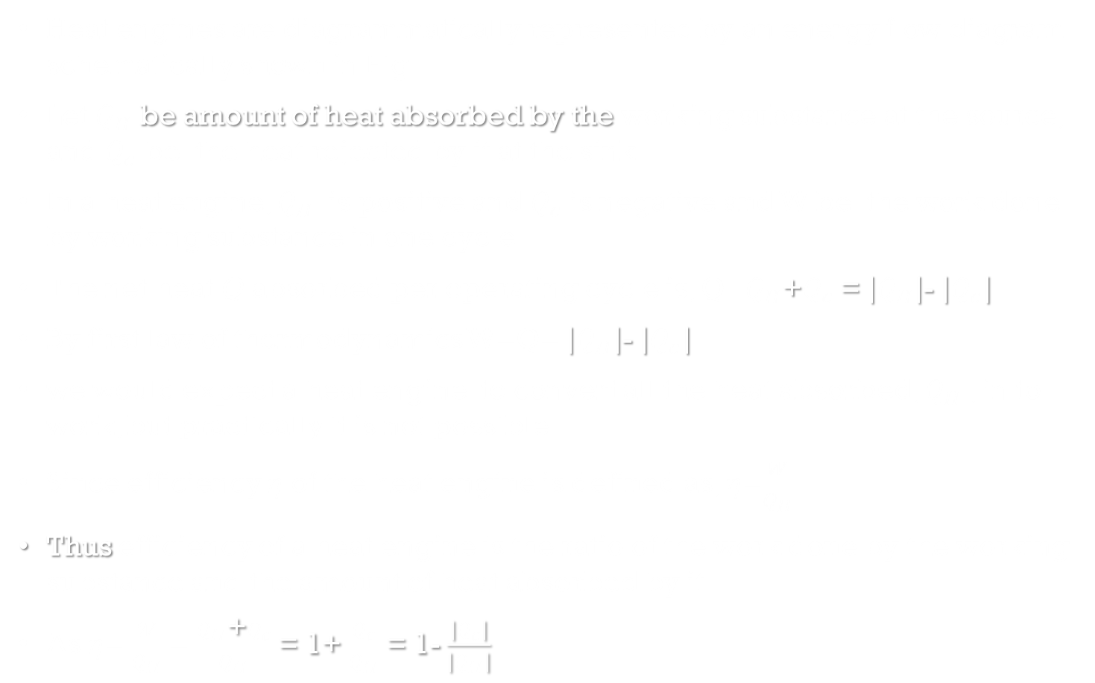
Working of heat engine
Heat engines are diagrammatically represented by an energy flow diagram schematically shown in Fig.
Let $Q_{H}$ be amount of heat absorbed by the working substance at the source, and $Q_{c}$ be the heat rejected by it at the sink.
In a heat engine, $Q_{H}$ is positive and $Q_{c}$ is negative and W be the work done by working substance in one cycle.
The net heat Q absorbed per operating cycle is, Q=$Q_{H}$+$Q_{c}$ = $\left|Q_{H}\right|$- $\left|Q_{c}\right|$
By first law of thermodynamics W=Q= $\left|Q_{H}\right|$- $\left|Q_{c}\right|$
we would expect a heat engine to convert all the heat absorbed, $Q_{H}$ , in to work, but practically it is not possible.
Since efficiency $η$ of the heat engine is defined as, $η$=$\frac{W}{Q_{H}}$
Thus efficiency of a heat engine is the ratio of the work done by the working substance and the amount of heat absorbed by it
As $η$= $\frac{W}{Q_{H}}$ = $\frac{Q_{H}\text{+}Q_{c}}{Q_{H}}$ = 1+ $\frac{Q_{c}}{Q_{H}}$ = 1- $\frac{\left|Q_{c}\right|}{\left|Q_{H}\right|}$

Slide 41
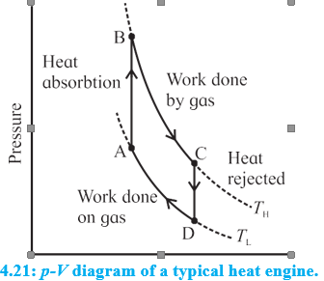
The Heat Engine Cycle and the p-V diagram
A heat engine uses energy absorbed in the form of heat to do work and then rejects the heat which cannot be used to do work
Heat is absorbed in one part of the cycle, work is done in another part, and the unused heat is rejected in yet other part of the cycle.
The P-V diagram of a typical heat engine is shown in Fig.
The operating cycle begins at the point A in the cycle.
The working substance (gas) in this case, absorbs heat at constant volume and no work is done by the gas or on the gas
The pressure is increased till the point B is reached.
The temperature of the gas also increases and its internal energy increases
The gas starts expanding by pushing the piston away and its volume changes from the point B to the point C.
Because the gas expands, its pressure is reduced. The gas does work in this part of the cycle
When the point C is reached, the excess heat, the heat that is not utilized in doing work by the gas, is rejected
The gas cools down and its internal energy decreases with volume remain constant.
The pressure of the gas is reduced and point D on the p-V diagram is reached
The gas is now compressed. Its volume decreases and its pressure increases. The change continues till the point A is reached.
The cycle is complete and the system is ready for the next cycle.

Slide 42
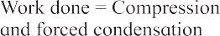
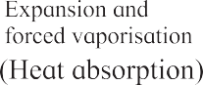
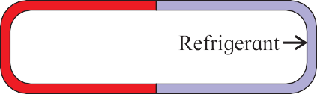
Refrigerators and Heat Pumps
Refrigerators and heat pumps are heat engines that work in backward direction. They convert mechanical work into heat
Since heat cannot flow from a region of lower temperature to a region of higher temperature on its own
We can force heat to flow from a region of lower temperature to a region of higher temperature by doing work on the system
this is achieved with the aid of phase change of a fluid, called the refrigerant
The refrigerant is forced to evaporate and then condense by successively decreasing and increasing its pressure
It can, therefore, ‘pump’ energy from a region at lower temperature to a region of higher temperature.
It extracts the heat of vaporization of the refrigerant from the cold region and rejects it to the hotter region outside the refrigerator
This results in cooling down the cold region further
Figure shows the concept of transferring heat from a cold region to a hot region in a schematic way

Slide 43
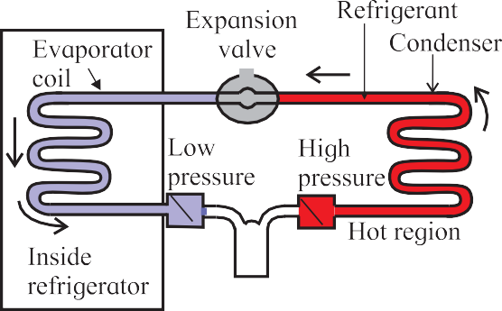
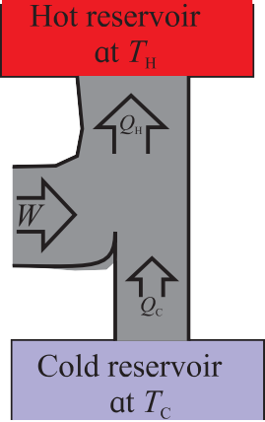
Refrigerator working
Figure shows the schematics of the mechanism used in a typical refrigerator.
It consists of a compressor, an expansion valve, and a closed tube which carries the refrigerant
Part of the tube, called the cooling coil, is in the region which is to be cooed at lower temperature and lower pressure
The other part which is exposed to the surrounding (generally, the atmosphere) is at a higher temperature and higher pressure
A fluid such as (fluorinated hydrocarbons) is used as refrigerant
Normally, the cold and the hot part of the coil contain the refrigerant as a mixture of liquid and vapor phase in equilibrium
As you can see in energy flow diagram, the heat extracted from a cold reservoir is supplemented by the mechanical work done (on the refrigerant) by the compressor and the total energy is rejected at the hot reservoir
The refrigerant goes through the following steps in one complete cycle of refrigeration

Slide 44
Step 1: The fluid passes through a nozzle and expands into a low-pressure area.
This is essentially an adiabatic expansion
Step 2: The cool gas is in thermal contact with the inner compartment of the fridge
It heats up as heat is transferred to it from the contents of the fridge
This takes place at constant pressure, so it's an isobaric expansion
Step 3: The gas is transferred to a compressor, which does most of the work in this process
The gas is compressed adiabatically, heating it and turning it back to a liquid
Step 4: The hot liquid passes through coils on the outside of the fridge, and heat is transferred to the atmosphere
This is an isobaric compression process
The compressor is driven by an external energy source and it does the work |W| on the working substance during each cycle

Slide 45
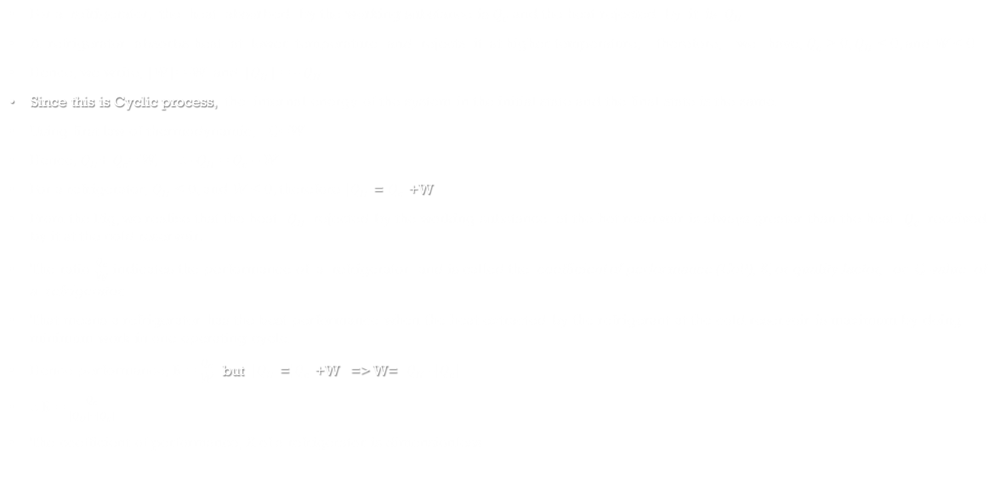
Performance of a Refrigerator
For a refrigerator, the heat absorbed by the working substance is $Q_{c}$ and the heat rejected by it is $Q_{H}$
A refrigerator absorbs heat at lower temperature and rejects it at higher temperature, therefore, we have, $Q_{c}$ > 0, $Q_{H}$ < 0, and W < 0.
Hence, we write, |W|=-W and |$Q_{H}$| = - $Q_{H}$
Since this is Cyclic process, the internal energy of the system in the initial state and the final state is the same.
Using first law of thermodynamic, Q=W
Hence, $Q_{H}$+ $Q_{c}$= W, $∴$ -$Q_{H}$ = $Q_{c}$ – W
For a refrigerator, $Q_{H}$ < 0, and W < 0, therefore $\left|Q_{H}\right|$=$\left|Q_{c}\right|$+W
From the Fig, we realize that the heat $\left|Q_{H}\right|$ rejected by the working substance at the hot reservoir is always greater than the heat $\left|Q_{c}\right|$ received by it at the cold reservoir.
The ratio $\frac{Q_{c}}{\text{W}}$ indicates the performance of a refrigerator and is called the coefficient of performance (CoP), K, or quality factor, or Q-value of a refrigerator.
That means a refrigerator has the best performance when the heat extracted by the refrigerant at the cold reservoir is maximum by doing minimum work in one operating cycle.
Hence performance, K = $\frac{Q_{c}}{\text{W}}$ but $\left|Q_{H}\right|$=$\left|Q_{c}\right|$+W => W= $\left|Q_{H}\right|$-$\left|Q_{c}\right|$
$∴$K = $\frac{Q_{c}}{\left|Q_{H}\right|\text{−}\left|Q_{c}\right|}$
The coefficient of performance, K of a refrigerator is dimensionless

